Slide 1

19CS2211 - Software Engineering
JUnit
Session 25

Slide 2

Outline
Agenda:
Junit Architecture
Test case
Assert methods

Slide 3
History
Kent Beck developed the first xUnit automated test tool for Smalltalk in mid-90’s.
Beck and Gamma (of design patterns Gang of Four) developed JUnit on a flight from Zurich to Washington, D.C.
Junit has become the standard tool for Test-Driven Development in Java (see Junit.org)
Junit test generators now part of many Java IDEs – Eclipse, BlueJ, Jbuilder, DrJava
Xunit tools have since been developed for many other languages – Perl, C++, Python, Visual Basic, C#, …

Slide 4
Why create a test suite?
Obviously you have to test your code—right?
You can do ad hoc testing (running whatever tests occur to you at the moment), or
You can build a test suite (a thorough set of tests that can be run at any time)
Disadvantages of a test suite
It’s a lot of extra programming
True, but use of a good test framework can help quite a bit
You don’t have time to do all that extra work
False! Experiments repeatedly show that test suites reduce debugging time more than the amount spent building the test suite
Advantages of a test suite
Reduces total number of bugs in delivered code
Makes code much more maintainable and re-factorable

Slide 5
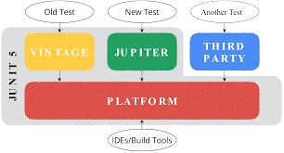
Junit – Basic Structure

Slide 6
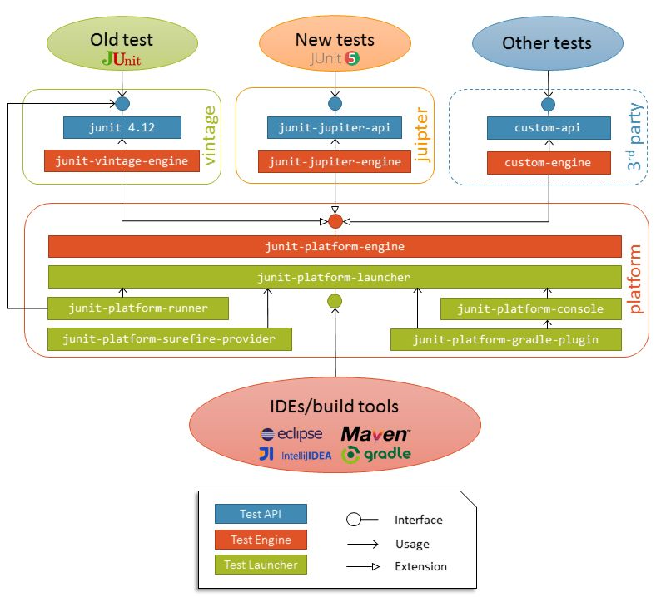
Junit - Detailed Architectural Overview

Slide 7
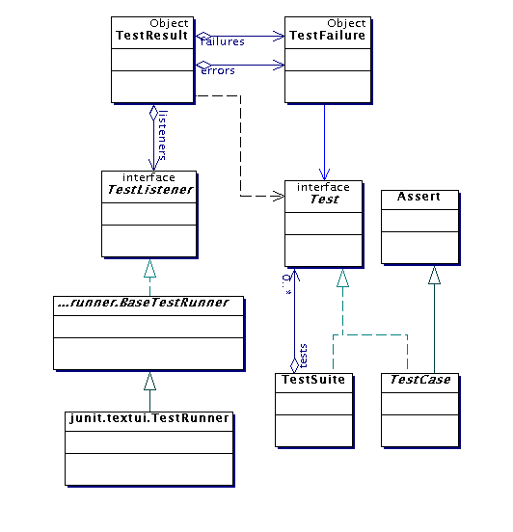
Architectural overview
JUnit test framework is a package of classes that lets you write tests for each method, then easily run those tests
TestRunner runs tests and reports TestResults
You test your class by extending abstract class TestCase
To write test cases, you need to know and understand the Assert class

Slide 8
Writing a TestCase
To start using JUnit, create a subclass of TestCase, to which you add test methods
Here’s a skeletal test class:
import junit.framework.TestCase;
public class TestBowl extends TestCase {
} //Test my class Bowl
Name of class is important – should be of the form TestMyClass or MyClassTest
This naming convention lets TestRunner automatically find your test classes

Slide 9
Writing methods in TestCase
Pattern follows programming by contract paradigm:
Set up preconditions
Exercise functionality being tested
Check postconditions
Example:
public void testEmptyList() {
Bowl emptyBowl = new Bowl();
assertEquals(“Size of an empty list should be zero.”,
0, emptyList.size());
assertTrue(“An empty bowl should report empty.”, emptyBowl.isEmpty());
}
Things to notice:
Specific method signature – public void testWhatever()
Allows them to be found and collected automatically by JUnit
Coding follows pattern
Notice the assert-type calls…

Slide 10
Assert methods
Each assert method has parameters like these: message, expected-value, actual-value
Assert methods dealing with floating point numbers get an additional argument, a tolerance
Each assert method has an equivalent version that does not take a message – however, this use is not recommended because:
messages helps documents the tests
messages provide additional information when reading failure logs

Slide 11
Assert methods Cont…
assertTrue(String message, Boolean test)
assertFalse(String message, Boolean test)
assertNull(String message, Object object)
assertNotNull(String message, Object object)
assertEquals(String message, Object expected, Object actual) (uses equals method)
assertSame(String message, Object expected, Object actual) (uses == operator)
assertNotSame(String message, Object expected, Object actual)

Slide 12
More stuff in test classes
Suppose you want to test a class Counter
public class CounterTest extends junit.framework.TestCase {
This is the unit test for the Counter class
public CounterTest() { } //Default constructor
protected void setUp()
Test fixture creates and initializes instance variables, etc.
protected void tearDown()
Releases any system resources used by the test fixture
public void testIncrement(), public void testDecrement()
These methods contain tests for the Counter methods increment(), decrement(), etc.
Note capitalization convention

Slide 13
JUnit tests for Counter
public class CounterTest extends junit.framework.TestCase { Counter counter1; public CounterTest() { } // default constructor
protected void setUp() { // creates a (simple) test fixture counter1 = new Counter(); }
public void testIncrement() { assertTrue(counter1.increment() == 1); assertTrue(counter1.increment() == 2); }
public void testDecrement() { assertTrue(counter1.decrement() == -1); } }
Note that each test begins with a brand new counter
This means you don’t have to worry about the order in which the tests are run

Slide 14
TestSuites
TestSuites collect a selection of tests to run them as a unit
Collections automatically use TestSuites, however to specify the order in which tests are run, write your own:
public static Test suite() {
suite.addTest(new TestBowl(“testBowl”));
suite.addTest(new TestBowl(“testAdding”));
return suite;
}
Should seldom have to write your own TestSuites as each method in your TestCase should be independent of all others
Can create TestSuites that test a whole package:
public static Test suite() {
TestSuite suite = new TestSuite();
suite.addTestSuite(TestBowl.class);
suite.addTestSuite(TestFruit.class);
return suite; }

Slide 15
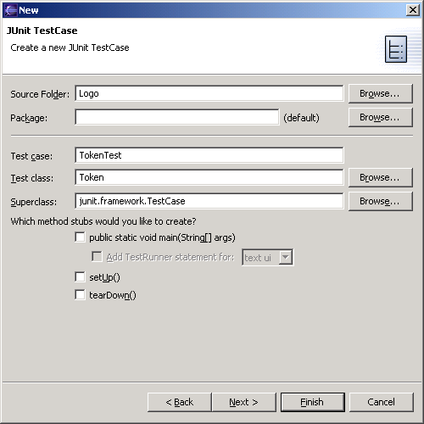
JUnit in Eclipse
To create a test class, select File→ New→ Other... → Java, JUnit, TestCase and enter the name of the class you will test
Fill this in
This will be filled in automatically

Slide 16
Results
Your results are here

Slide 17
Unit testing for other languages
Unit testing tools differentiate between:
Errors (unanticipated problems caught by exceptions)
Failures (anticipated problems checked with assertions)
Basic unit of testing:
CPPUNIT_ASSERT(Bool) examines an expression
CPPUnit has variety of test classes (e.g. TestFixture)
Inherit from them and overload methods

Slide 18
More Information
http://www.junit.org
Download of JUnit
Lots of information on using JUnit
http://sourceforge.net/projects/cppunit
C++ port of Junit
http://www.thecoadletter.com
Information on Test-Driven Development

Slide 19
Thank You

